Slide 1
Chapter 2
E-Marketplaces: Mechanisms, Tools, and Impacts of E-commerce

Slide 2
Learning Objectives
Describe the major electronic commerce (EC) activities and processes and the mechanisms that support them.
Define e-marketplaces and list their components.
List the major types of e-marketplaces and describe their features.
Describe electronic catalogs, search engines, and shopping carts.
Describe the major types of auctions and list their characteristics.

Slide 3
Learning Objectives
Discuss the benefits, limitations, and impacts of auctions.
Describe bartering and negotiating online.
List the major Web 2.0 tools and their use in EC.
Understand virtual worlds and their use in EC.
Discuss competition in the digital economy.
Describe the impact of e-marketplaces on organizations, intermediation, and industries.

Slide 4
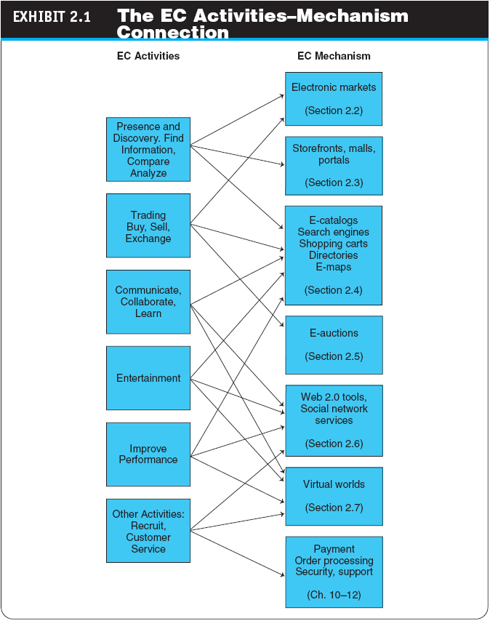

Slide 5
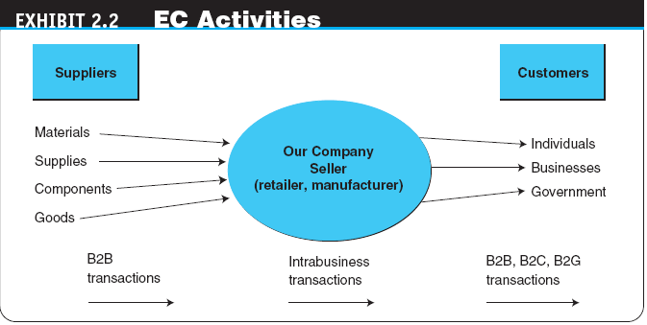

Slide 6
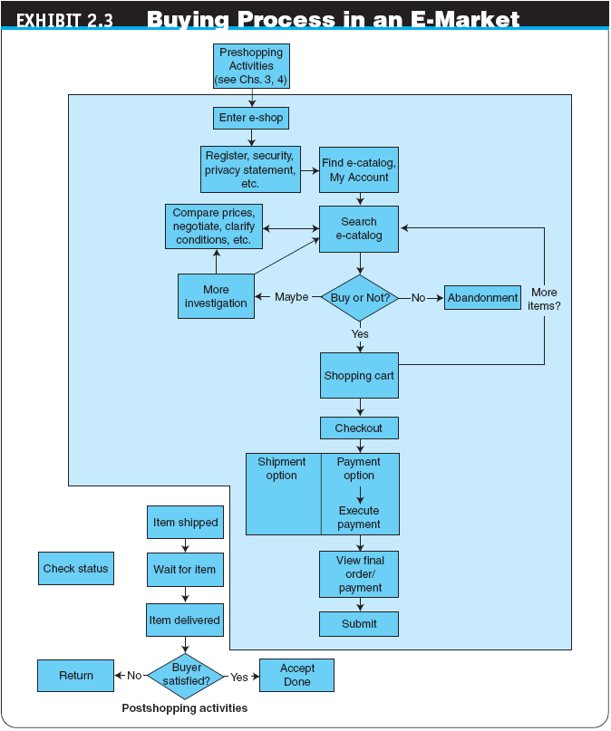

Slide 7
E-Marketplaces
e-marketplace
An online market, usually B2B, in which buyers and sellers exchange goods or services; the three types of e-marketplaces are private, public, and consortia
marketspace
A marketplace in which sellers and buyers exchange goods and services for money (or for other goods and services), but do so electronically

Slide 8
E-Marketplaces
E-MARKETPLACE COMPONENTS AND PARTICIPANTS
digital products
Goods that can be transformed to digital format and delivered over the Internet
front end
The portion of an e-seller’s business processes through which customers interact, including the seller’s portal, electronic catalogs, a shopping cart, a search engine, and a payment gateway

Slide 9
E-Marketplaces
back end
The activities that support online order fulfillment, inventory management, purchasing from suppliers, payment processing, packaging, and delivery
intermediary
A third party that operates between sellers and buyers

Slide 10
E-Marketplaces
TYPES OF E-MARKETPLACES
Private E-Marketplaces
sell-side e-marketplace
A private e-marketplace in which one company sells either standard and/or customized products to qualified companies (one-to-many)
buy-side e-marketplace
A private e-marketplace in which one company makes purchases from invited suppliers (many-to-one)
Public E-Marketplaces (eg exchange, manyto-many)

Slide 11
Customer Interaction Mechanisms: Storefronts, Malls, and Portals
storefront
A single company’s Web site where products or services are sold
e-mall (online mall)
An online shopping center where many online stores are located

Slide 12
Customer Interaction Mechanisms: Storefronts, Malls, and Portals
TYPES OF STORES AND MALLS
General stores/malls (eg amazon.com, yahoo.com)
Specialized stores/malls
Regional versus global stores
Pure-play online organizations versus click-and-mortar stores
Web portal
A single point of access, through a Web browser, to critical business information located inside and outside (via Internet) of an organization

Slide 13
Customer Interaction Mechanisms: Storefronts, Malls, and Portals
Types of Portals
Commercial (public) portal (eg. msn.com, yahoo.com)
Corporate portals
Publishing portals
Personal portals
mobile portal
A portal accessible via a mobile device
voice portal
A portal accessed by telephone or cell phone
Knowledge portals

Slide 14
Customer Interaction Mechanisms: Storefronts, Malls, and Portals
THE ROLES AND VALUE OF INTERMEDIARIES IN E-MARKETPLACES
infomediaries
Electronic intermediaries that provide and/or control information flow in cyberspace, often aggregating information and selling it to others
e-distributor
An e-commerce intermediary that connects manufacturers with business buyers (customers) by aggregating the catalogs of many manufacturers in one place—the intermediary’s Web site

Slide 15
Electronic Catalogs, Search Engines, and Shopping Carts
electronic catalogs (e-catalogs)
The presentation of product information in an electronic form; the backbone of most e-selling sites
Online Catalogs Versus Paper Catalogs
EC SEARCH ACTIVITIES, TYPES, AND ENGINES
Types of EC Searches
Internet/Web Search
enterprise search
The practice of identifying and enabling specific content across the enterprise to be indexed, searched, and displayed to authorized users

Slide 16
Electronic Catalogs, Search Engines, and Shopping Carts
desktop search
Search tools that search the contents of a user’s or organization’s computer files, rather than searching the Internet. The emphasis is on finding all the information that is available on the user’s PC, including Web browser histories, e-mail archives, and word-processed documents, as well as in all internal files and databases

Slide 17
Electronic Catalogs, Search Engines, and Shopping Carts
search engine
A computer program that can access databases of Internet resources, search for specific information or keywords, and report the results
Software (Intelligent) Agents
Voice-Powered Search

Slide 18
Electronic Catalogs, Search Engines, and Shopping Carts
electronic shopping cart
An order-processing technology that allows customers to accumulate items they wish to buy while they continue to shop
Product Configuration

Slide 19
Auctions, Bartering, and Negotiating Online
auction
A competitive process in which a seller solicits consecutive bids from buyers (forward auctions) or a buyer solicits bids from sellers (backward auctions). Prices are determined dynamically by the bids
electronic auctions (e-auctions)
Auctions conducted online
Innovative Auctions

Slide 20
Auctions, Bartering, and Negotiating Online
dynamic pricing
Prices that change based on supply and demand relationships at any given time
One Buyer, One Seller
One Seller, Many Potential Buyers
forward auction
An auction in which a seller entertains bids from buyers. Bidders increase price sequentially

Slide 21
Auctions, Bartering, and Negotiating Online
reverse auction (bidding or tendering system)
Auction in which the buyer places an item for bid (tender) on a request for quote (RFQ) system, potential suppliers bid on the job, with the price reducing sequentially, and the lowest bid wins; primarily a B2B or G2B mechanism
“name-your-own-price” model
Auction model in which a would-be buyer specifies the price (and other terms) he or she is willing to pay to any willing and able seller. It is a C2B model that was pioneered by Priceline.com

Slide 22
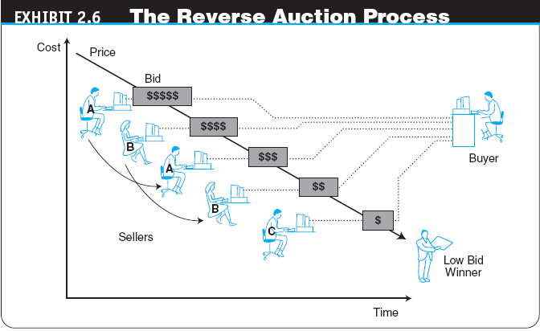

Slide 23
Auctions, Bartering, and Negotiating Online
Many Sellers, Many Buyers
double auction
An auction in which multiple buyers and their bidding prices are matched with multiple sellers and their asking prices, considering the quantities on both sides
Copyright © 2009 Pearson Education, Inc. Publishing as Prentice Hall

Slide 24
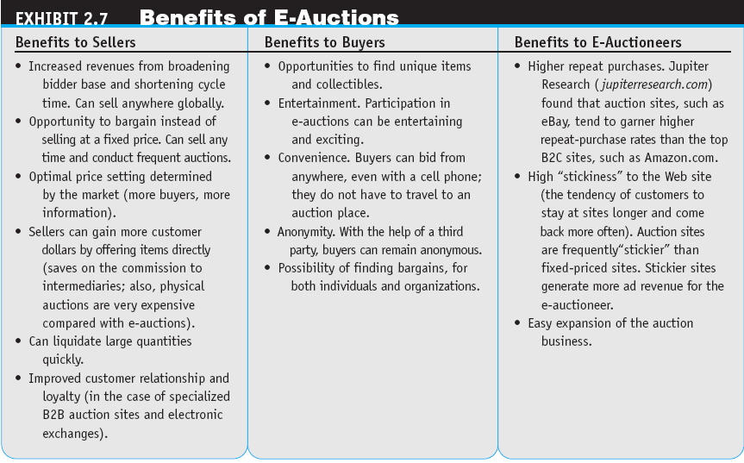

Slide 25
Auctions, Bartering, and Negotiating Online
Limitations of E-Auctions
Minimal Security
Possibility of Fraud
Limited Participation
Impacts of Auctions
Auctions as a Coordination Mechanism
Auctions as a Social Mechanism to Determine a Price
Auctions as a Highly Visible Distribution Mechanism
Auctions as an EC Component
Auctions for Profit for Individuals

Slide 26
Auctions, Bartering, and Negotiating Online
ONLINE BARTERING
bartering
The exchange of goods and services
e-bartering (electronic bartering)
Bartering conducted online, usually in a bartering exchange
bartering exchange
A marketplace in which an intermediary arranges barter transactions
ONLINE NEGOTIATING

Slide 27
Web 2.0 Tools and Services: From Blogs to Wikis
BLOGGING (WEBLOGGING)
blog
A personal Web site that is open to the public to read and to interact with; dedicated to specific topics or issues
vlog (or video blog)
A blog with video content

Slide 28
Web 2.0 Tools and Services: From Blogs to Wikis
micro-blogging
A form of blogging that allows users to write messages (usually up to 140 characters) and publish them, either to be viewed by anyone or by a restricted group that can be chosen by the user. These messages can be submitted by a variety of means, including text messaging, instant messaging, e-mail, MP3, or just on the Web (e.g. Twitter)

Slide 29
Web 2.0 Tools and Services: From Blogs to Wikis
Twitter
A free micro-blogging service that allows its users to send and read other users’ updates.
tweets
Text-based posts up to 140 characters in length posted to Twitter
Commercial Uses of Blogs
Using Blogging to Facilitate Collaboration
Potential Risks of Corporate Blogs
Bloggers and Politics

Slide 30
Web 2.0 Tools and Services: From Blogs to Wikis
Mechanism Aids for Web 2.0 Tools
tag
A nonhierarchical keyword or term assigned to a piece of information (such as an Internet bookmark, digital image, video clip, or any computer document)
folksonomy (collaborative tagging, social classification, social indexing, social tagging)
The practice and method of collaboratively creating, classifying, and managing tags to annotate and categorize content

Slide 31
Web 2.0 Tools and Services: From Blogs to Wikis
social bookmarking
Web service for sharing Internet bookmarks. The sites are a popular way to store, classify, share, and search links through the practice of folksonomy techniques on the Internet and intranets
wiki (wikilog)
A blog that allows everyone to participate as a peer; anyone may add, delete, or change content

Slide 32
Virtual Worlds As an Electronic Commerce Mechanism
avatars
Animated computer characters that exhibit humanlike movements and behaviors
BUSINESS ACTIVITIES AND VALUE IN VIRTUAL WORLDS
Types of business activities in virtual worlds:
Creating and managing a virtual business
Conducting regular business activities
Providing services for those who build, manage, or make money with virtual properties

Slide 33
Competition in the Digital Economy and Its Impact on Industries
COMPETITION IN THE INTERNET ECOSYSTEM
Competitiveness Factors
Lower search costs for buyers
Speedy comparisons
Lower prices
Customer service
Barriers to entry are reduced
Virtual partnerships multiply
Market niches abound
differentiation
Providing a product or service that is unique

Slide 34
Competition in the Digital Economy and Its Impact on Industries
Customization, Personalization, and Competition
customization
Creation of a product or service according to the buyer’s specifications
personalization
The ability to tailor a product, service, or Web content to specific user preferences

Slide 35
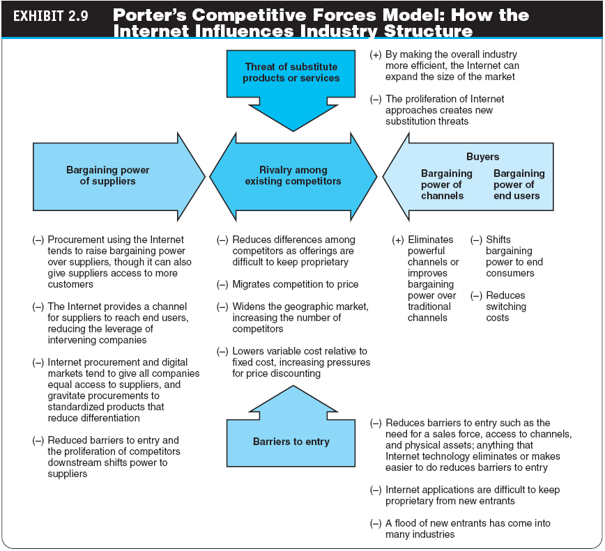

Slide 36
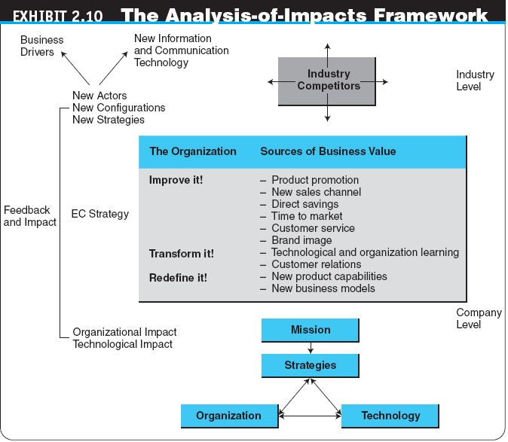

Slide 37
Impacts of Electronic Commerce on Business Processes and Organizations
TRANSFORMING ORGANIZATIONS
Technology and Organizational Learning
The Changing Nature of Work
Disintermediation and Reintermediation
disintermediation
Elimination of intermediaries between sellers and buyers
reintermediation
Disintermediated entities or newcomers take on new intermediary roles

Slide 38
Impacts of Electronic Commerce on Business Processes and Organizations
REDEFINING ORGANIZATIONS
New and Improved Product Capabilities
mass customization
A method that enables manufacturers to create specific products for each customer based on the customer’s exact needs
build-to-order (pull system)
A manufacturing process that starts with an order (usually customized). Once the order is paid for, the vendor starts to fulfill it

Slide 39
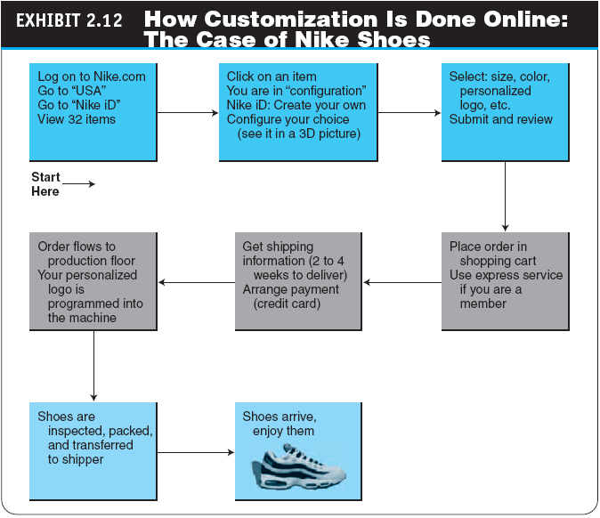

Slide 40
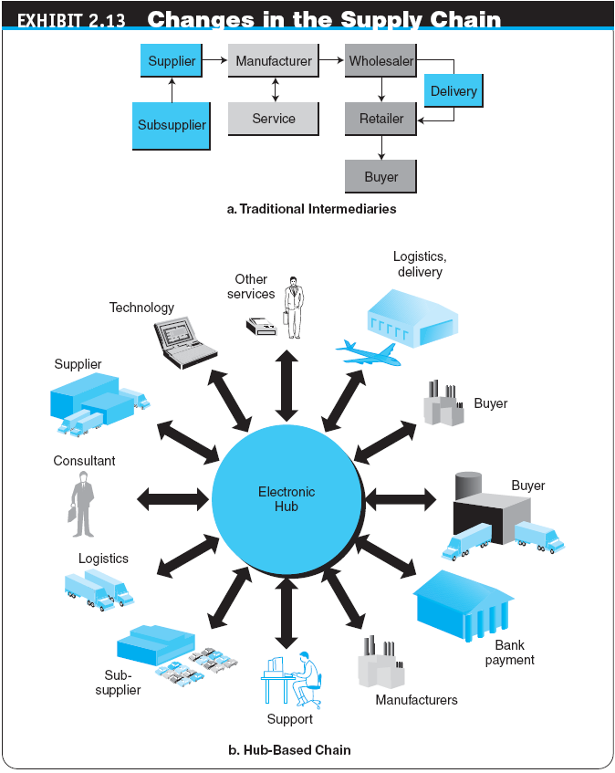

Slide 41
Managerial Issues
What about intermediaries?
Should we auction?
Should we barter?
How do we compete in the digital economy?
What organizational changes will be needed?

